Slide 1


Realizing atomicity:
Logging + Checkpoint
SE3331-1 (2025 Fall)
IPADS, Shanghai Jiao Tong University
https://www.sjtu.edu.cn

Slide 2
Review + outline of today’ s lecture
The all-or-nothing atomicity is desirable to ensure consistency under failure
  For consistency across systems, e.g., bank application or file systems
Realizing all-or-nothing requires some designs, the main technique is logging
  Shadow copy
  Redo logging & undo-redo logging
  Checkpoint (Logging also requires checkpointing!)
Case studies of checkpointing
  Where checkpoint itself can also realize fault tolerance (e.g., in LLM training)

Slide 3
Review: all-or-nothing atomicity
It's easy for users to reason about correctness assuming
  Everything has only one-copy
  The overall behavior is equivalent to some serial behavior
  The operations that need to be executed in an atomic unit (usually called operations belonging to a transaction) are executed on a machine that happens completely or not at all (all-or-nothing atomicity)
All-or-nothing atomicity makes it much easier to reason about failures
  Need to think about the consequences of the action happening or not happening, but not about the action partially happening

Slide 4
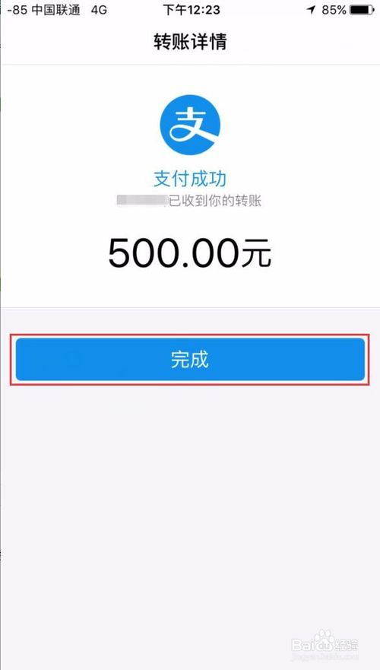
Review of motivation example: Bank transfer
Suppose we want to implement a bank application, w/ the following two requirements
  The data must be persistently stored
  It has to support basic transfer operations
For simplicity, we assume only 1 machine as a server execute this function
  So linearizability is enabled by default
transfer(bank, a, b, amt):
bank[a] = bank[a] – amt
bank[b] = bank[b] + amt

Slide 5
Review: shadow copy
Ensure a set of operations written to a file is all-or-nothing
  E.g., writes records a & b to the bank file
High-level idea (copy-on-write):
  Do not modify the old copy (there is always a consistent copy)
  Replace the original file with the updates only if all the writes to are successful
Original
Shadow copy
transfer(bank, a, b, amt):
records = mmap(bank, ...)
records[a] = records[a] – amt
records[b] = records[b] + amt
fsync(bank, ...)
transfer(bank, a, b, amt):
fcopy(bank, bank_temp)
records = mmap(bank_temp, ...)
records[a] = records[a] – amt
records[b] = records[b] + amt
fsync(bank_temp, ...)
rename(bank_temp,bank)

Slide 6
Review: rename should be atomic!
Shadow copy
transfer(bank, a, b, amt):
fcopy(bank, bank_temp)
records = mmap(bank_temp, ...)
records[a] = records[a] – amt
records[b] = records[b] + amt
fsync(bank_temp, ...)
rename(bank_temp,bank)
Question: what happen if a crash happens during rename?
  For the bank transfer, it is consistent
But without controlling, the filesystem state will become inconsistent

Slide 7
Review of Journaling
Key approach
  Avoid updating the disk states until we can recovery it after failure
Record before update
  Record changes in journal
  Commit journal
  Update
Crash before commit:
- No data is changed
- Discard journal
Crash after commit:
- Journal is complete
- Redo changes in journal

Slide 8

Review: Journaling Drawbacks
Why not using journaling to make fsync atomic?
Everything is written to the disk twice
  Once in the journal
  The other at the home location
Become problematic when the files are large

Slide 9
Drawbacks of shadow copy
Question: what would happen if multiple clients share the same file?
Example:
Client 0
Client 1
transfer(bank, a, b, amt):
fcopy(bank, bank_temp)
records = mmap(bank_temp, ...)
records[a] = records[a] – amt
records[b] = records[b] + amt
fsync(bank_temp, ...)
rename(bank_temp,bank)
transfer(bank, c, d, amt):
fcopy(bank, bank_temp)
records = mmap(bank_temp, ...)
records[c] = records[c] – amt
records[d] = records[d] + amt
fsync(bank_temp, ...)
rename(bank_temp,bank)

Slide 10
Issue: ensure multiple files update is complex
Question: what would happen if multiple clients share the same file?
  Client 0 transfers 100 from a to b
a = 100
b = 100
c = 100
d = 100
a = 100
b = 100
c = 100
d = 100
Bank
Bank_temp
Time
Create shadow file
Update a

Slide 11
Issue: ensure multiple files update is complex
Question: what would happen if multiple clients share the same file?
  Client 0 transfers 100 from a to b
a = 100
b = 100
c = 100
d = 100
a = 100
b = 100
c = 100
d = 100
a = 0
b = 100
c = 100
d = 100
Bank
Bank_temp
Cache
Time
Create shadow file
Update a

Slide 12
Issue: ensure multiple files update is complex
Question: what would happen if multiple clients share the same file?
  Client 0 transfers 100 from a to b
  Client 1 transfers 100 from c to d
a = 100
b = 100
c = 100
d = 100
a = 100
b = 100
c = 100
d = 100
a = 0
b = 100
c = 100
d = 100
Bank
Bank_temp
Cache
Question: can client 1 directly create a new bank_temp?
Time
Create shadow file
Update a

Slide 13
Issue: ensure multiple files update is complex
Question: what would happen if multiple clients share the same file?
  Client 0 transfers 100 from a to b
  Client 1 transfers 100 from c to d
a = 100
b = 100
c = 100
d = 100
a = 100
b = 100
c = 100
d = 100
a = 0
b = 100
c = 100
d = 100
Bank
Bank_temp
Cache
No. Because it will overwrite client 0’s results.
We can only reuse existing file
Time
Create shadow file
Update a

Slide 14
Issue: ensure multiple files update is complex
Question: what would happen if multiple clients share the same file?
  Client 0 transfers 100 from a to b
  Client 1 transfers 100 from c to d
a = 100
b = 100
c = 100
d = 100
a = 100
b = 100
c = 100
d = 100
a = 0
b = 100
c = 0
d = 200
Bank
Bank_temp
Cache
Client 0 stuck, e.g., due to interrupts
Time
Create shadow file
Update a
Update c,d

Slide 15
Issue: ensure multiple files update is complex
Question: what would happen if multiple clients share the same file?
  Client 0 transfers 100 from a to b
  Client 1 transfers 100 from c to d
a = 100
b = 100
c = 100
d = 100
a = 0
b = 100
c = 0
d = 200
a = 0
b = 100
c = 0
d = 200
Bank
Bank_temp
Cache
Time
Create shadow file
Update a
Update c,d
fsync

Slide 16

Issue: ensure multiple files update is complex
Question: what would happen if multiple clients share the same file?
  Client 0 transfers 100 from a to b
  Client 1 transfers 100 from c to d
a = 0
b = 100
c = 0
d = 200
Bank
Client 1 writes client 0’s intermediate
results. So it must wait…
Time
Create shadow file
Update a
Update c,d
fsync
Client 1 done

Slide 17
Summary: drawbacks of shadow copy
  Only one operation can happen at a time
    Naively executing concurrent transfer can cause consistency issue
    Even these operations in principle can run concurrently
  Hard to generalize to multiple files or directories
    Have to place all files in a single directory, or rename subdirs
    Or application-specific implementation is required
  Requires copying the entire file for any (small) change, though can be optimized with techniques like copy-on-write

Slide 18
Logging for atomicity

Slide 19
Logging
Log entry
Append
Log file
Key idea (journaling w/ a more general form)
  Avoid updating the disk state until we can recovery it after failure
How to achieve so in shadow copy or journaling?
  Shadow copy buffers the updates in a copy of the origin file
  Journaling buffers the updates in a sector (can be viewed as a small log)
We can generalize journaling by storing all the updates in a log
  Log file: a file only contains the updated results
  Log entries: contain the updated values of an atomic unit (e.g., transfer)

Slide 20

Transaction and Commit Point: marking atomic units
If the point has passed, the transaction is all.
Useful to applications, e.g., notify users about the completion of the transaction.

Slide 21
Transaction and Commit Point
Log entry
Append
Log file
We call a set of operations that needs to be atomic "transaction”
Transaction typically provides interfaces for applications to mark the atomicity granularity of operations
  TX.begin()
  TX.commit()
Each update between a begin() & commit() are stored in a log entry
  Can be replayed via replaying each entry of the log
Commit point
  The time when we are sure the operation is “all”

Slide 22
First try: commit logging
Log entry
Append
Log file
transfer(bank, a, b, amt, log): // amt=10
records = mmap(bank, ...)
new_a = records[a] – amt
new_b = records[b] + amt
commit_log = "log start: a:" + new_a + "\b:" + new_b
log.append(commit_log).sync()
records[a] = new_a
records[b] = new_b
Updates are buffered in the memory
  To prevent writing a temporal value to the disk

Slide 23
First try: commit logging
Log entry
Append
Log file
transfer(bank, a, b, amt, log): // amt=10
records = mmap(bank, ...)
new_a = records[a] – amt
new_b = records[b] + amt
commit_log = "log start: a:" + new_a + "\b:" + new_b
log.append(commit_log).sync()
records[a] = new_a
records[b] = new_b
Before we write the disk, write the log to the disk synchronously
  Question: do we need these two steps to be atomic? How to achieve so?

Slide 24
First try: commit logging
Log entry
Append
Log file
transfer(bank, a, b, amt, log): // amt=10
records = mmap(bank, ...)
new_a = records[a] – amt
new_b = records[b] + amt
commit_log = "log start: a:" + new_a + "\b:" + new_b
log.append(commit_log).sync()
records[a] = new_a
records[b] = new_b
Before we write the disk, write the log to the disk synchronously
  Question: how to ensure the logged entry is complete?
  Simple: we can use a checksum

Slide 25
First try: commit logging
Log entry
Append
Log file
transfer(bank, a, b, amt, log): // amt=10
records = mmap(bank, ...)
new_a = records[a] – amt
new_b = records[b] + amt
commit_log = "log start: a:" + new_a + "\b:" + new_b
log.append(commit_log).sync()
records[a] = new_a
records[b] = new_b
After the logging succeed, we can update the disk states

Slide 26
First try: commit logging
Log entry
Append
Log file
transfer(bank, a, b, amt, log): // amt=10
records = mmap(bank, ...)
new_a = records[a] – amt
new_b = records[b] + amt
commit_log = "log start: a:" + new_a + "\b:" + new_b
log.append(commit_log).sync()
records[a] = new_a
records[b] = new_b
fsync(bank) // ?
Question: do we need to add fsync to flush the modifications to the bank file?
  Not necessary, because we can do the recovery

Slide 27
Crash recovery of commit log
Log entry
Append
Log file
After reboot, we need to recover the systems to a consistent state
  Based on the log entries stored in the log file
Rules
  Travel from start to end
  Re-apply the updates recorded in a complete log entry

Slide 28
First try: commit logging
Log entry
Append
Log file
transfer(bank, a, b, amt, log): // amt=10
records = mmap(bank, ...)
new_a = records[a] – amt
new_b = records[b] + amt
commit_log = "log start: a:" + new_a + "\b:" + new_b
log.append(commit_log).sync()
record[a] = new_a
record[b] = new_b
Question: What is the commit point of this transaction? (transfer)
  The line after log.append(commit_log).sync()

Slide 29
Quick summary: commit logging (redo-only logging)
Keep a log of all update actions
  Redo all the updates upon recovery
  Note: REDO does not necessary be the same as DO
Log
Old
State
DO
New
State
Log
Old
State
REDO
New
State
Log

Slide 30
Pros & Cons of redo-only logging so far
Pros
  The commit is extremely efficient: only one file append operations (w/ updated data)
    Other methods, e.g., shadow copy copies the entire file
Cons
  All updates must be buffered in the memory until the transaction commits
    What if there is insufficient memory?
  The log file is continuously growing while most its updates are already flushed to the disk (unless the machine is rebooted or crashed, and we do the recovery)

Slide 31
Pros & Cons of redo-only logging so far
Pros
  The commit is extremely efficient: only one file append operations (w/ updated data)
    Other methods, e.g., shadow copy copies the entire file
Cons
  All updates must be buffered in the memory until the transaction commits
    What if there is insufficient memory?
  The log file is continuously growing while most its updates are already flushed to the disk
Unlike filesystem journaling, the user can commit a lot of entries in a transaction
Notes:
我们先讲怎么解决前两个问题

Slide 32
Naïve solution: swapping
The OS swaps memory pages to a small disk file (swapfile) if insufficient DRAM
Drawback in our case
  Storage usage: in the worst case, the data will be duplicated (e.g., if the TX touches all the data)
  Hard to analyze the performance: the swap is done by the OS, so the application is unable to control & model

Slide 33
Basic solution of undo-only logging
We allow the transaction directly writing uncommitted values to the disk
  Before the commit point to free-up memory space & utilize disk I/O
transfer(bank, a, b, amt, log): // amt=10
records = mmap(bank, ...)
records[a] = records[a] – amt
records[b] = records[b] + amt
The OS will flush the page back if
out of the memory
Problem
  How to prevent a partial updates from uncommitted transactions?
Idea: use log to undo updates of uncommitted transactions!

Slide 34
Logging w/ undo
Before updates, write an undo log record to the log file
  Should contain sufficient information to undo uncommitted transactions
  E.g., old values
Question: Do we need a redo record?
transfer(bank, a, b, amt, log): // amt=10
records = mmap(bank, ...)
log.append(...).sync()
records[a] = records[a] – amt
log.append(...).sync()
records[b] = records[b] + amt
Action (file name, offset, old value)

Slide 35
Logging w/ undo-redo logging
Question: do we need the redo entry?
  Depends on whether we wait for records[a] to be written to the disk (e.g., sync)
  Typically, yes: piggybacking the redo is efficient, and we can omit adding redo to the commit log
transfer(bank, a, b, amt, log): // amt=10
records = mmap(bank, ...)
log.append(...).sync()
records[a] = records[a] – amt
log.append(...).sync()
records[b] = records[b] + amt
log.append("TX {id} commit”).sync()
Action (file name, offset, old & new values)

Slide 36
Log entry vs. log record
Redo-only logging appends log entry to the log file
  Containing all the updates of the transaction
Und—redo logging appends log records to the log file
  Containing the updates of a single operation
  Log records from different transaction (TX) may possibly interleave
    E.g., the OS schedules the transaction out
    Therefore, we further need pointer to trace operations from the same TX
Record
Entry
Append
Append
Log file
Log file

Slide 37
Put it all together: log record in undo-do logging
Each log record consists of
  Transaction ID
  Operation ID
  Pointer to previous record in this transaction
  Value (file name, offset, old & new value)
  …
Log
TID=1, OID=2, PTR=80,
ACT={A, 23, 3000, 2000}

Slide 38
Recovery rules
How to recover from crash?
Read the log and recover states according to its content
Rules:
  Travel from end to start
Log

Slide 39

Recovery rules
How to recover from crash?
Read the log and recover states according to its content
Rules:
  Travel from end to start
  Mark all transaction’s log record w/o CMT log and append ABORT log
Log

Slide 40
Recovery rules
How to recover from crash?
Read the log and recover states according to its content
Rules:
  Travel from end to start
  Mark all transaction’s log record w/o CMT log and append ABORT log
  UNDO ABORT logs from end to start
UNDO
Log

Slide 41
Recovery rules
How to recover from crash?
Read the log and recover states according to its content
Rules:
  Travel from end to start
  Mark all transaction’s log record w/o CMT log and append ABORT log
  UNDO ABORT logs from end to start
  REDO CMT logs from start to end
REDO
Log

Slide 42
Summary: the type of logging
Keep a log of all update actions
  The log can undo the (partial) updates of a DO operation
Log
Old
State
DO
New
State
Log
New
State
UNDO
Old
State
Log
Old
State
REDO
New
State
Log

Slide 43
Undo-redo logging vs. redo-only logging
Question:
  Which one is faster during execution?
  Which one is faster during recovery?
Redo-only logging
  Less disk operations compared with undo-redo logging
  Only need one scan of the entire log file
Redo-only logging is typically preferred except for TXs with large in-memory states

Slide 44
UNDO-only Logging
Logging rules
  Append UNDO log record before flushing state modification
  State modification must be flushed before transaction committed
    w/o REDO
Rarely used
  Much slower than UNDO-REDO logging during execution

Slide 45
Final issue left: continuously growing of the log file
Both redo-only logging & undo-redo logging append to the log file
  The log file is continuously growing while most its updates are already flushed to the disk
  A large log file also makes recovery slow
  A large log file also consumes non-trivial storage space
Typically, a machine fails less frequently
  E.g., one per day
Question: how to reduce the log size?

Slide 46
Key method: checkpointing
Checkpoint: save the system state to a compact form such that the re-execution (restore) is faster
  Example system state#1: files after recovering the logs
  Example system state#2: trained parameters of LLMs
  Example system state#3: process memory (including CPUs and GPUs)
  Example system state#4: chat history in our eventually consistent ChatAPP
The high-level concept is similar, but the detailed checkpoint method is workload/system (e.g., LLM training or eventual consistency) dependent
Notes:
TBD: ask GPT whwat is checkpoint

Slide 47
Case study#1: checkpoint in logging

Slide 48
Checkpoint in log
Naïve solution
  Run the recovery process. If it is done, then we can discard all the log file
  Problem: too slow
Observation
  Uncommitted updates are only in the page cache
  If we can flush all the page cache to the disk, then the committed TX’s log can be discarded
Challenge: maintain correctness
  A checkpoint is correct if a resumed execution from it preserves a possible execution system states w/o the checkpoint
  Things could go wrong: ongoing TXs during the checkpoint

Slide 49
How to checkpoint?
How to checkpoint?
  Wait till no operation is in progress
  Write a CKPT record to log
    Contains a list of all transaction in process
    and their logs
  Flush the page cache
  Discard all the log records except the CKPT record

Slide 50

Recovery with checkpoint
Checkpoint
T1
Crash
T2
T3
T4
T5
  T1: do nothing
  T2：redo from the log from checkpoint + its log
  T3: redo from its log
  T4: undo from the log from checkpoint + its log
  T5: undo from its own log

Slide 51
Case study#2: checkpoint in LLM (pre)training
& How we configure the checkpoint frequency
Credit: Some contents are from Jiali Wang @ IPADS

Slide 52
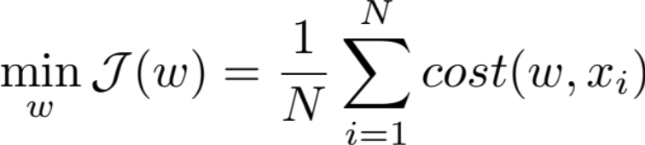
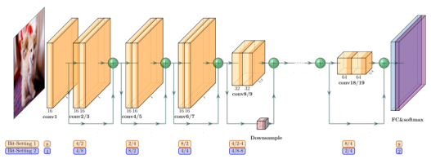
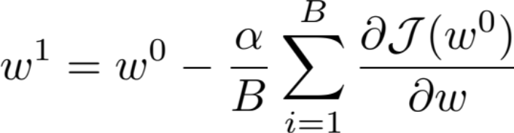
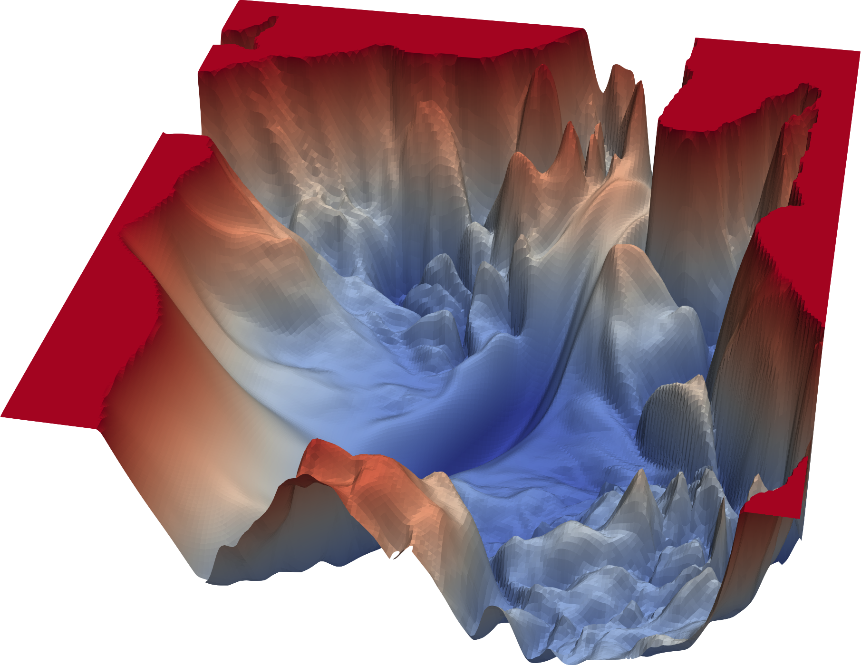

Background: LLM training
The model parameters
Learning rate
Two key elements:
The computed gradient: the direction
The learning rate: how big a step do we take?

Slide 53
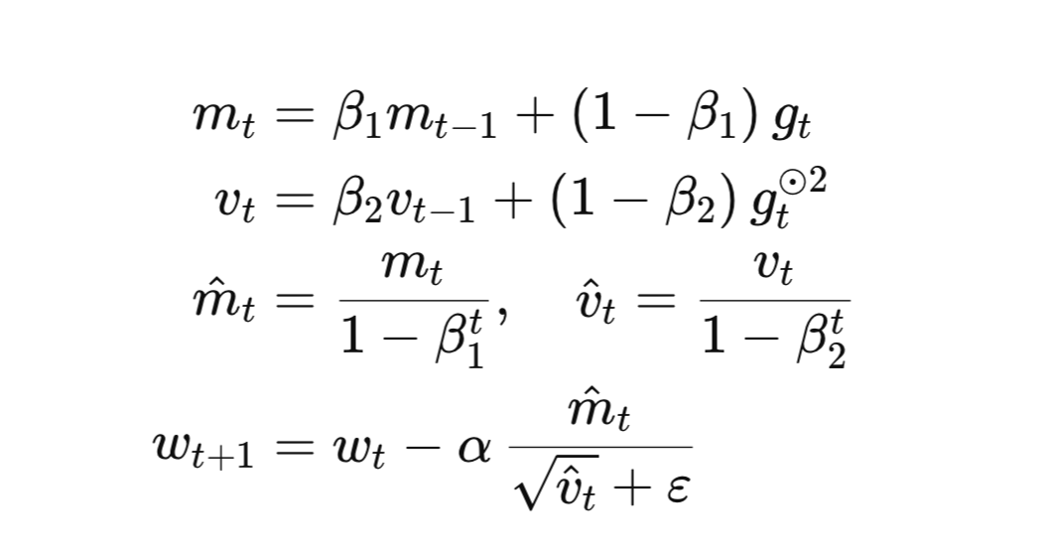
Background: LLM training w/ optimizer
How to learn given the gradient?
  A big topic in AI community. To achieve stable training, we need some advanced method
  E.g., Adam
Optimizer state
Model weights
The famous Adam optimizer

Slide 54
Background: LLM training (Logic view)
Iter 1
Iter 2
Iter 3
…
Iter N
1
1
1
2
2
2
3
3
3
N
N
N
Update
Backward
Forward

Slide 55

Background: LLM training (System view)
We will talk about more details later, but we can give an overview
Iter 1
Iter 2
Iter 3
…
Iter N
1
1
1
2
2
2
3
3
3
N
N
N
= Optimizer state + Model weight
1
1
1
1
1
Aggregate
updates
1
1
1
1
1
1
1

Slide 56
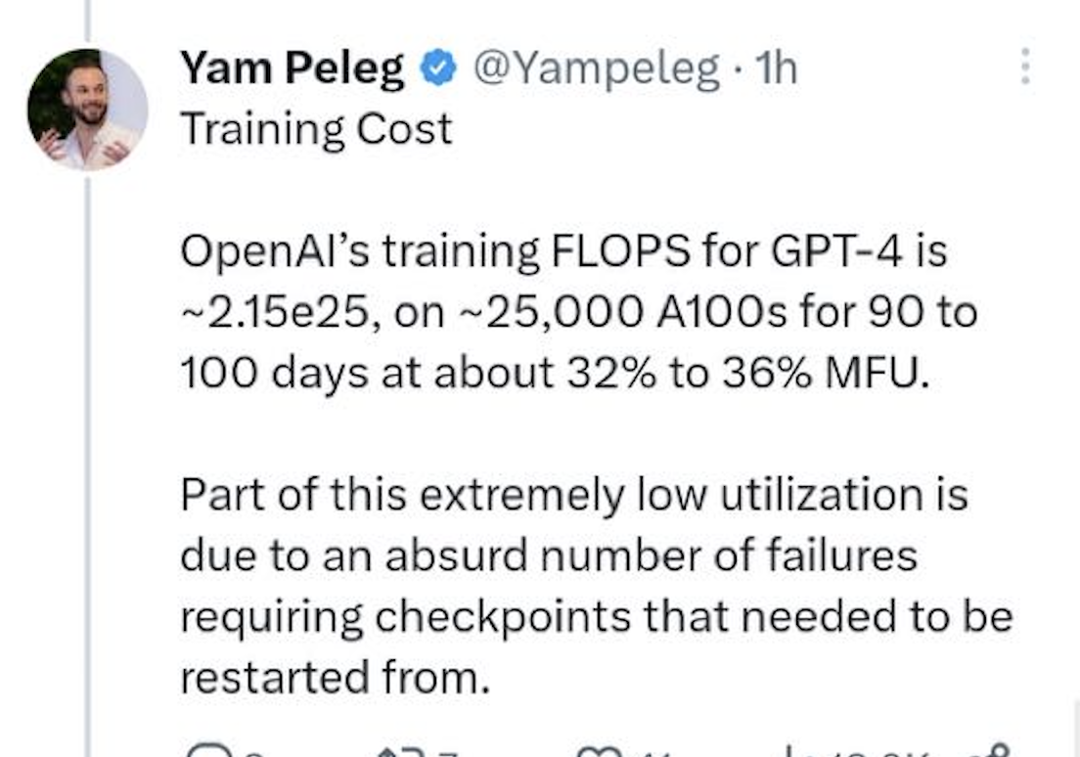
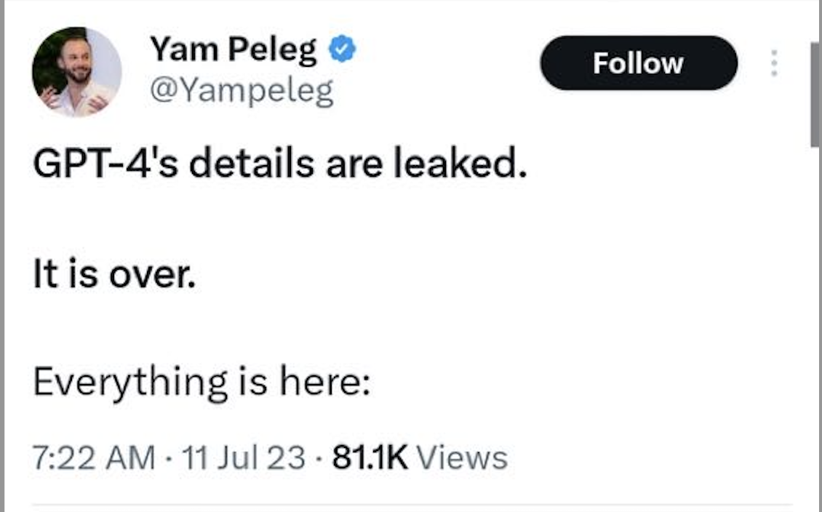

Slide 57

Tolerating failure is important in LLM training!
We will talk about more details later, but we can give an overview
Iter 1
Iter 2
Iter 3
…
Iter N
1
1
1
2
2
2
3
3
3
N
N
N
= Optimizer state + Model weight
1
1
1
1
1
Aggregate
updates
1
1
1
1
1
1
1

Slide 58
Using checkpoint to provide fault tolerance for LLM training
Failure occurs at some training iteration …
…
…
1
1
1
2
2
2
9
9
9

Slide 59
Using checkpoint to provide fault tolerance for LLM training
Failure occurs at some training iteration …
…
…
1
1
1
2
2
2
9
9
9
Checkpoint: Checkpoint: save the system state to a compact form such that the re-execution (restore) is faster (e.g., checkpoint at iteration 4)
Restart only at iteration 4
…
…
₄
₄
₄
9
9
9

Slide 60

Using checkpoint to provide fault tolerance for LLM training
Iter 1
Iter 2
Iter 3
…
Iter N
1
1
1
CKPT
2
2
2
3
3
3
N
N
N
File system
Checkpoint (CKPT): store the optimizer state + parameters to a persistent state
  E.g., File system
Question: do CKPT operation needs all-or-nothing atomicity?
  As it involves multiple operations, e.g., writing the optimizer state + weights

Slide 61
System goal #1: the checkpoint must be atomic (for correctness)
Iter 1
Iter 2
Iter 3
…
Iter N
1
1
1
CKPT
2
2
2
3
3
3
N
N
N
Optimizer state
Weights
File page
GPU
File system

Slide 62
System goal #1: the checkpoint must be atomic (for correctness)
Iter 1
Iter 2
Iter 3
…
Iter N
1
1
1
CKPT
2
2
2
3
3
3
N
N
N
Recall: which technique we can use?
  Idea: shadow copy!
Beginning: maintain a complete checkpoint
  E.g., the first checkpoint is always complete
If a checkpoint succeeds, then replace the previous copy

Slide 63
Checkpoint vs Logging in LLM training
Iter 1
Iter 2
Iter 3
…
Iter N
1
1
1
CKPT
2
2
2
3
3
3
N
N
N
If the ckpt done per-iteration, then checkpoint fallbacks to redo-only logging
  The forward + backward + update
The difference is that log truncation is simple
  Using the application semantic: simply drop previous checkpoints
Question: is LLM trained with per-iteration checkpointing appropriate? ?

Slide 64
System goal #2: reduce fault tolerance overhead
Iter 1
Iter 2
Iter 3
…
Iter N
1
1
1
CKPT
2
2
2
3
3
3
N
N
N
GPUs are idle
GPUs are wasted due to checkpoint because they are stopped
  By default. Why? To ensure the checkpoint is correct (recall our file checkpoint)
  The checkpoint time is typically non-trivial (because the model is large!)
Question: what will happen if we do a per-iteration checkpoint?
  Can we reduce the checkpoint frequency?

Slide 65

Question: can we reduce the overhead by reducing the frequency?
Not so easy. Low frequency causes checkpoint overhead
  i.e., if we do checkpoint per-5 iteration, in the worst case we need to re-compute 4 iteration computation
Failure Overhead = Checkpoint overhead + Recomputation
lost iter, $≈\frac{CHPT Interval}{2}$

Slide 66
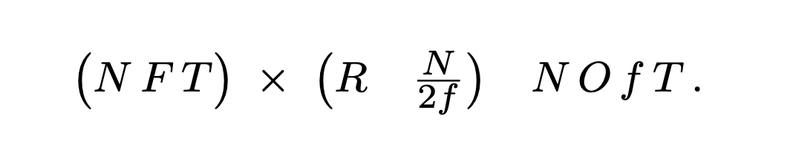
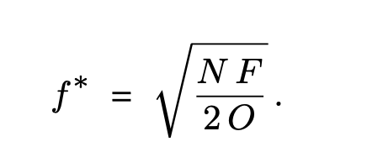
The performance model of checkpoint overhead
For more details, check the appendix of PhoenixOS: Concurrent OS-level GPU Checkpoint and Restore with Validated Speculation @ SOSP’25
Recovery time upon a failure
Total training time
+
+
Checkpoint overhead
Number of GPU
Checkpoint frequency
Failure frequency
Optimal checkpoint frequency

Slide 67
System goal #2: reduce fault tolerance overhead
+
+
Reduce checkpoint overhead directly implies less overhead
  Overlap checkpoint with execution (PhoenixOS@SOSP’25, CheckFreq@FAST’21)
  Accelerate checkpoint write speed (Gemini@SOSP’23)
  Reduce checkpoint size (ByteCheckpoint@NSDI’25)
  The list continuously grows
The methods are fairly simple, please refer to these papers for more details

Slide 68
Case study#3: checkpoint in an eventually consistent system

Slide 69
Review: eventual consistency
A specific of weak consistency model, informally:
  All servers eventually receives all writes, and servers holding the same set of writes will have the same data contents
  Thus, if no new updates are made to the data, eventually all accesses will return the last update value

Slide 70
Review: implementing eventual consistency w/ logging
X
Y
Client
SRV1
SRV2
iPhone
Post X
Post Y
sync
X (pos=10)
Y (pos=10)
Y (pos=11)
Time
X (pos=11)
Will Server1 show X in front of Y, and Server2 show Y in front of X?
Challenge: how to decide the ordering?

Slide 71
Review: implementing eventual consistency w/ logging
Syncing: ensure both nodes have the same updates in log
Ordered list of updates at each node
  Record the updates in a log, and sort it according to the same order
X
Y
Client
SRV1
SRV2
iPhone
Post x
Post Y
sync
Post X
Post Y
Post Y
Time
Post X
Log
Log
Notes:
不能直接apply；要delay
sync：保证大家的write都一样了；然后再apply
讲动画

Slide 72
Review: implementing eventual consistency w/ logging
Syncing: ensure both nodes have the same updates in log
Ordered list of updates at each node
  Record the updates in a log, and sort it according to the same order
X
Y
Client
SRV1
SRV2
iPhone
Post X
Post Y
Sort
sync
Sort
Post X
Post X
Post Y
Time
Post Y
Log
Log
Notes:
不能直接apply；要delay
sync：保证大家的write都一样了；然后再apply
讲动画

Slide 73
Review: implementing eventual consistency w/ logging
Syncing: ensure both nodes have the same updates in log
Ordered list of updates at each node
  Record the updates in a log, and sort it according to the same order
Re-apply sorted updates after the sync; overwrite existing content if necessary
X
Y
Client
SRV1
SRV2
iPhone
Post X
Post Y
sync
Post X
X
X
Post X
Post Y
Y
Time
Y
Post Y
Notes:
不能直接apply；要delay
sync：保证大家的write都一样了；然后再apply
讲动画

Slide 74
Review: implementing eventual consistency w/ logging
Syncing: ensure both nodes have the same updates in log
Ordered list of updates at each node
  Record the updates in a log, and sort it according to the same order
X
Y
Client
SRV1
SRV2
iPhone
Post X
Post Y
Sort
sync
Sort
Post X
Post X
Post Y
Time
Post Y
Log
Log
Notes:
不能直接apply；要delay
sync：保证大家的write都一样了；然后再apply
讲动画

Slide 75
Question: what will happen if the log continuously growing?
Issue
  The syncing process become slower
  The space used by the log is becoming larger
Goal
  Avoid re-run all the operations
  Reduce the log size
Method
  Using checkpoint!
Challenge
  We cannot simply apply the operations because they can be reordered!
Notes:
inefficient:
- sync performance
- log size
想想：怎么才能做呢？

Slide 76
Idea: distinguish tentative writes from stable ones
Each server’s log consists of 2 portions:
  Stable writes, followed by
  Tentative writes
Stable writes are not rolled backup upon sync
  They cannot be reordered
Question
  How to determine which writes are stable? (hint: using the lamport clock!)
Answer
  An update (W) is stable iff no entries will have a lamport timestamp < W

Slide 77
De-centralized approach
Commit (write) scheme
  Update <10, A> is stable if all nodes have seen all updates with time <= 10
    Because it will never see a timestamp < 10 (according to the rule of lamport time)
    Still so many writes may be rolled back on re-connect
Problem: If any node is offline, the stable portion of all logs stops growing

Slide 78
Centralized approach
Commit scheme
  One server designated “primary”
    Assign a total commit order: CSN to each write
    Complete timestamp: <CSN, local-TS, SrvID>
    Any write with a known CSN is stable
  All stable writes are ordered before tentative writes
  CSNs are exchanged between servers
    CSNs define a total order for committed update
CSN: Commit-Seq-No
Advantage: as long as the primary is up, writes can be committed and stabilized
Notes:
Any write with a known CSN is stable
Why? Because later writes will have a larger CSN
中央服务器怎么容错？可以放数据中心，网络连接比较稳定

Slide 79
Does CSN order preserve causality?
Complete timestamp: <CSN, local-TS, SrvID>
Should do some works
  A server asks the primary to assign CSN for all tentative writes (include those received from others)
    i.e., the primary can assign a larger CSN for a dependent write

Slide 80
Summary of today’ s lecture
The all-or-nothing atomicity is desirable to ensure consistency under failure
  For consistency across systems, e.g., bank application or file systems
Realizing all-or-nothing requires some designs, the main technique is logging
  Shadow copy
  Redo logging & undo-redo logging
  Checkpoint (Logging also requires checkpointing!)
Case studies of checkpointing
  Where checkpoint itself can also realize fault tolerance (e.g., in LLM training)

